Slide 1
MONTHLY PLANNER & BUDGET ANALYZER
Developed using java
  Developed by: Nivedhitha-2620030175
  Sindhura-2620030140
Notes:
Introduce the project: a Java console application designed for tracking personal monthly expenses and analyzing budget allocations.

Slide 2
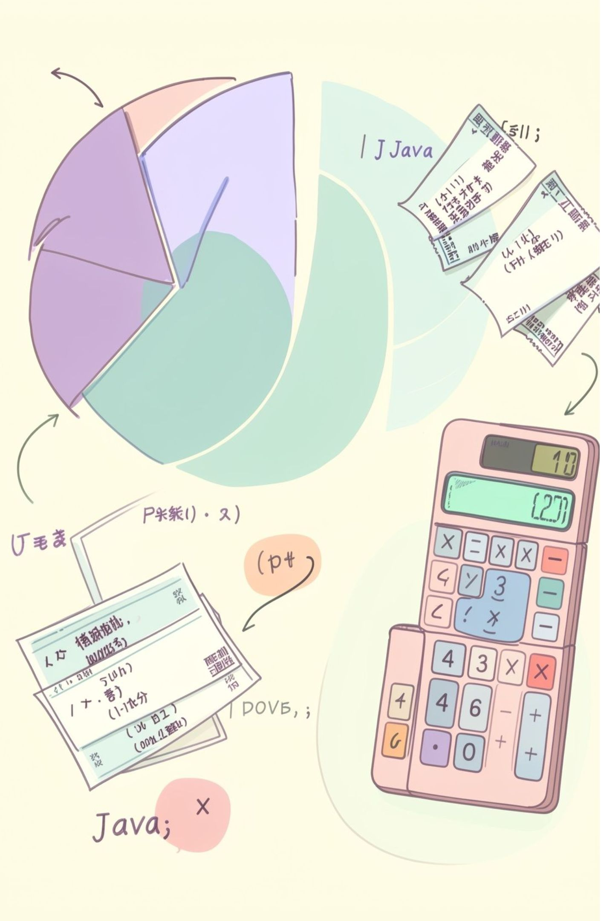
ABSTRACT
A Java-based console application that helps users manage monthly expenses.
01
User enters a monthly budget
02
Add expenses under Rent, Groceries, Education, Medical, Transport and Entertainment
03
Calculate total expenses and compare them with the budget
04
Show remaining amount or overspending
05
Generate a summary report
Notes:
Summarize the core capabilities of the application: budget input, six expense categories, automated calculation, and summary reporting.

Slide 3




INTRODUCTION / OBJECTIVE
Problem
Project objective
Managing multiple expenses manually can be time-consuming
Calculating total expenses separately can be inconvenient
It may be difficult to know whether the monthly budget has been exceeded
Create a simple Java application for managing monthly expenses
Store expenses category-wise
Automatically calculate total expenses
Check budget status
Provide a summary report
→
Notes:
Walk through the problem-solution pipeline: transition from error-prone manual calculations to an automated Java console tool.

Slide 4




EXISTING SYSTEM VS PROPOSED SYSTEM
BEFORE
AFTER
Existing System
Proposed System
Manual recording of expenses
Separate calculations
Difficult to track category-wise spending
No automatic budget status
Menu-driven Java application
Category-wise expense tracking
Automatic total calculation
Automatic budget comparison
Summary report
Notes:
Highlight the direct contrast: manual logs and separate math versus a structured menu-driven Java architecture with automated status reporting.

Slide 5






CO ATTAINMENTS
CO1
CO2
CO3
Module 1
Module 2
Module 3
Variables & data types
Operators
Java program structure
Scanner / Console I/O
if-else
switch-case
for loop
do-while
break & default
1D arrays
Array traversal
Summation
Notes:
Present course outcome mappings across three modules: fundamentals, control flow mechanisms for menus, and array operations for storing amounts.

Slide 6




RESULT / SAMPLE OUTPUT
Enter Monthly Budget
Main Menu
Add Expense
View Expenses
Calculate Total Expenses
Check Budget Status
Summary Report
Exit
If total expenses > budget → OVER BUDGET + overspending amount
Otherwise → WITHIN BUDGET + remaining amount
Monthly Budget: ₹60,000
Total Expenses: ₹48,500
Remaining: ₹11,500
Status: WITHIN BUDGET
Notes:
Demonstrate the step-by-step menu execution flow alongside test run values verifying successful budget calculation within limits.

